Slide 1


Credit Card Analytics
The ZOOKEEPERS
GUIDE : Venkat Sir
DE Expert (Sensei)
Akhil
Shubham
Gaurav
Ashpak
Kanika
Karthik

Slide 2
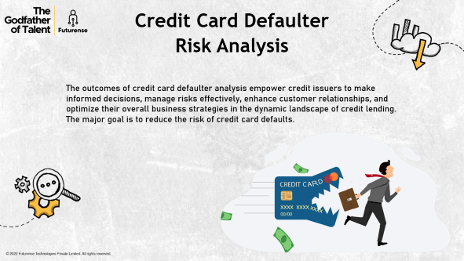
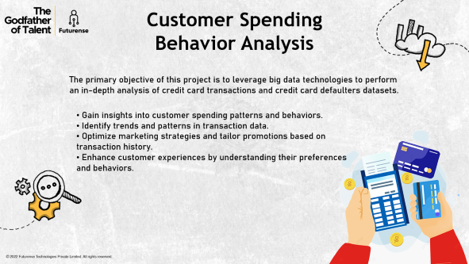
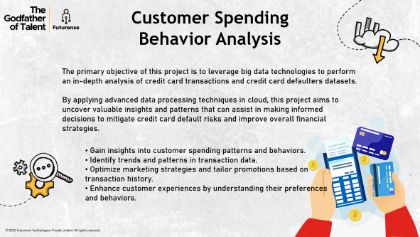
Business Problem/Overview
In this project, we have 2 problems – Transactions problem & Defaulters problem.

Slide 3

Customer Spending Behavior Analysis
The primary objective of this project is to leverage big data technologies to perform an in-depth analysis of credit card transactions and credit card defaulters datasets.
Gain insights into customer spending patterns and behaviors.
Identify trends and patterns in transaction data.
Optimize marketing strategies and tailor promotions based on transaction history.
Enhance customer experiences by understanding their preferences and behaviors.

Slide 4

Credit Card Defaulter Risk Analysis
The outcomes of credit card defaulter analysis empower credit issuers to make informed decisions, manage risks effectively, enhance customer relationships, and optimize their overall business strategies in the dynamic landscape of credit lending.
The major goal is to reduce the risk of credit card defaults.

Slide 5














Architecture of the solution
SOURCE
DATA INGESTION
DATA STORAGE & ANALYSIS
VISUALIZATION
HIVE
DATAFRAME
RDD
SNOWFLAKE

Slide 6
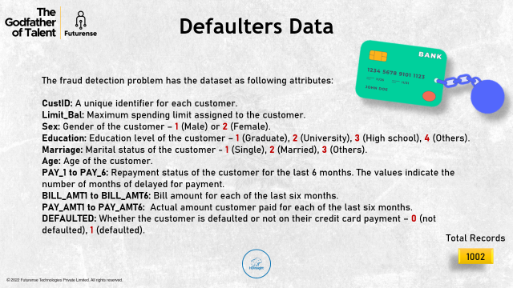
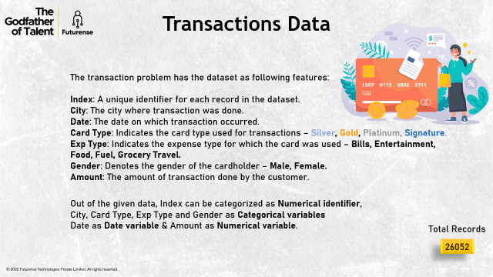
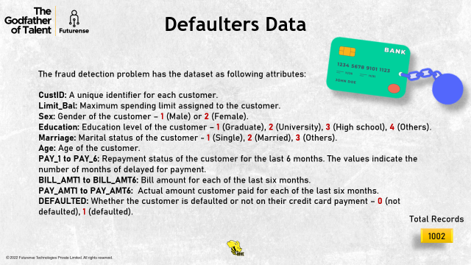

Data Representation
For the given problems, we have 2 different datasets – one for the transactions problem and another for Defaulters problem.

Slide 7

Transactions Data
The transaction problem has the dataset as following features:
Index: A unique identifier for each record in the dataset.
City: The city where transaction was done.
Date: The date on which transaction occurred.
Card Type: Indicates the card type used for transactions – Silver, Gold, Platinum, Signature.
Exp Type: Indicates the expense type for which the card was used – Bills, Entertainment, Food, Fuel, Grocery Travel.
Gender: Denotes the gender of the cardholder – Male, Female.
Amount: The amount of transaction done by the customer.
Out of the given data, Index can be categorized as Numerical identifier,
City, Card Type, Exp Type and Gender as Categorical variables
Date as Date variable & Amount as Numerical variable.
Total Records
26052

Slide 8
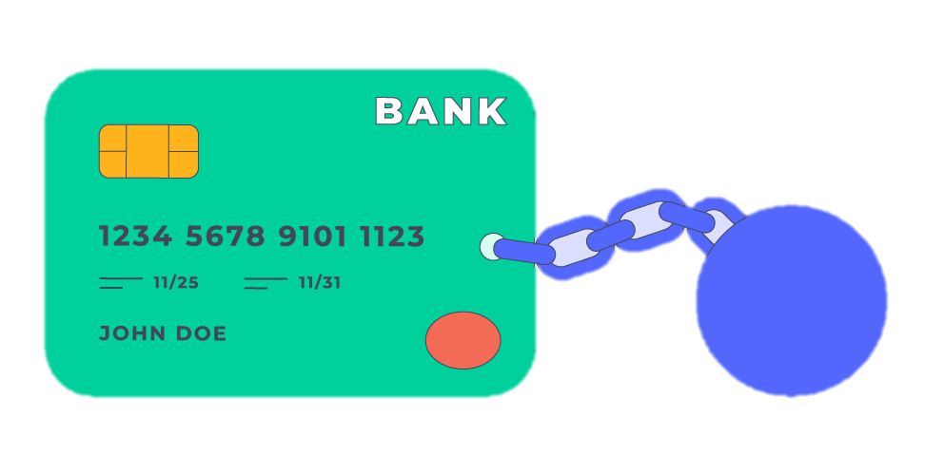

Defaulters Data
The fraud detection problem has the dataset as following attributes:
CustID: A unique identifier for each customer.
Limit_Bal: Maximum spending limit assigned to the customer.
Sex: Gender of the customer – 1 (Male) or 2 (Female).
Education: Education level of the customer – 1 (Graduate), 2 (University), 3 (High school), 4 (Others).
Marriage: Marital status of the customer - 1 (Single), 2 (Married), 3 (Others).
Age: Age of the customer.
PAY_1 to PAY_6: Repayment status of the customer for the last 6 months. The values indicate the number of months of delayed for payment.
BILL_AMT1 to BILL_AMT6: Bill amount for each of the last six months.
PAY_AMT1 to PAY_AMT6: Actual amount customer paid for each of the last six months.
DEFAULTED: Whether the customer is defaulted or not on their credit card payment – 0 (not defaulted), 1 (defaulted).
Total Records
1002

Slide 9
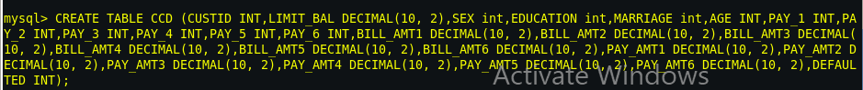
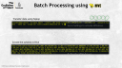
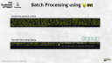
Batch Processing using
Creating the table
Using the following command we will load the data in the table created
LOAD DATA INFILE '/home/cloudera/CCD_ProcessedData.csv' INTO TABLE CreditCardData FIELDS TERMINATED BY ',' (@var1,@var2,@var3,@var4,@var5,@var6,@var7) SET Date=STR_TO_DATE(@var1,'%d-%m-
%Y'),Low=@var2,Open=@var3,Volume=@var4,high=@var5,Close=@var6,Adjusted _close=@var7;

Slide 10
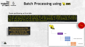
Batch Processing using
Create the schema in Hive
Transfer data using Sqoop

Slide 11
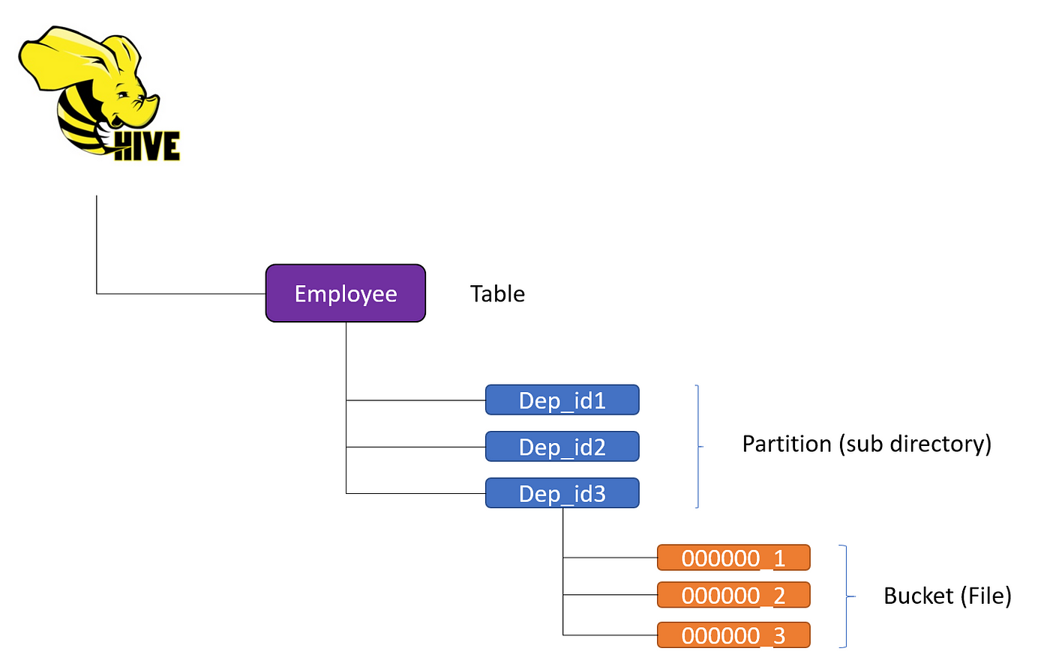
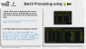
Batch Processing using
Create partitioning on Hive table
OPTIMIZED
Partitioning is one of the optimization techniques used in Hive to improve the performance of the query

Slide 12
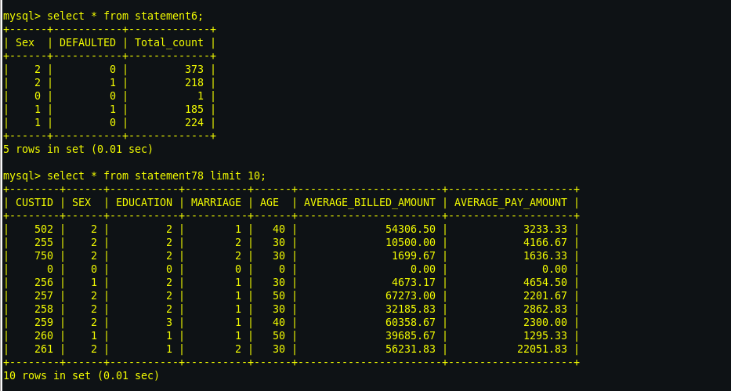

Batch Processing using
1. Write a SQL query to determine the count of defaulted (1) and non-defaulted (0) records for both males and females in the Credit Card Data table.
SELECT SEX,DEFAULTED,COUNT(*) AS COUNT FROM CCDP GROUP BY SEX, DEFAULTED;
2. average billed Amount & average pay amount
SELECT CUSTID, SEX, EDUCATION, MARRIAGE, AGE, AVG((BILL_AMT1 + BILL_AMT2 + BILL_AMT3 + BILL_AMT4 + BILL_AMT5 + BILL_AMT6) / 6) AS AVERAGE_BILLED_AMOUNT, AVG((PAY_AMT1 + PAY_AMT2 + PAY_AMT3 + PAY_AMT4 + PAY_AMT5 + PAY_AMT6) / 6) AS AVERAGE_PAY_AMOUNT FROM CCDP GROUP BY CUSTID,SEX,EDUCATION,MARRIAGE,AGE;

Slide 14

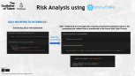
Risk Analysis using
Data Pre-Processing
Data Ingestion
Data Visualization
Mounting
Data Analysis
Data Storage

Slide 15
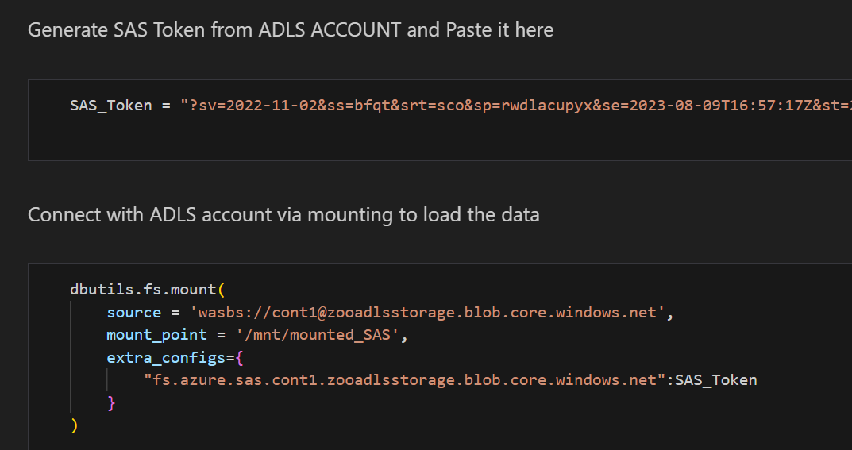
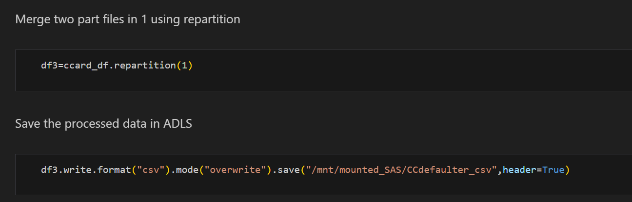
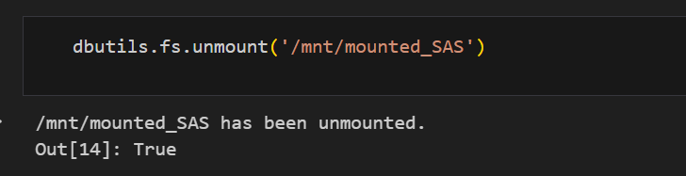
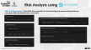
Risk Analysis using
ADLS MOUNTING TO DATABRICKS :
After completing the thorough data cleaning and preprocessing procedures, the processed and refined data is transferred to the Azure Data Lake Factory
Connecting ADLS with Databricks
Data Pre-processing

Slide 16
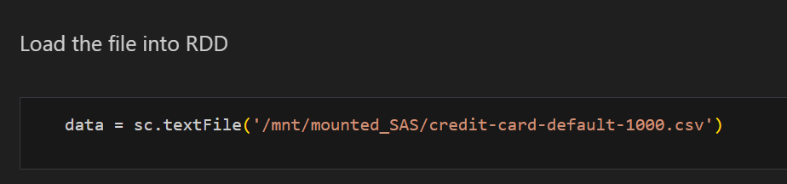
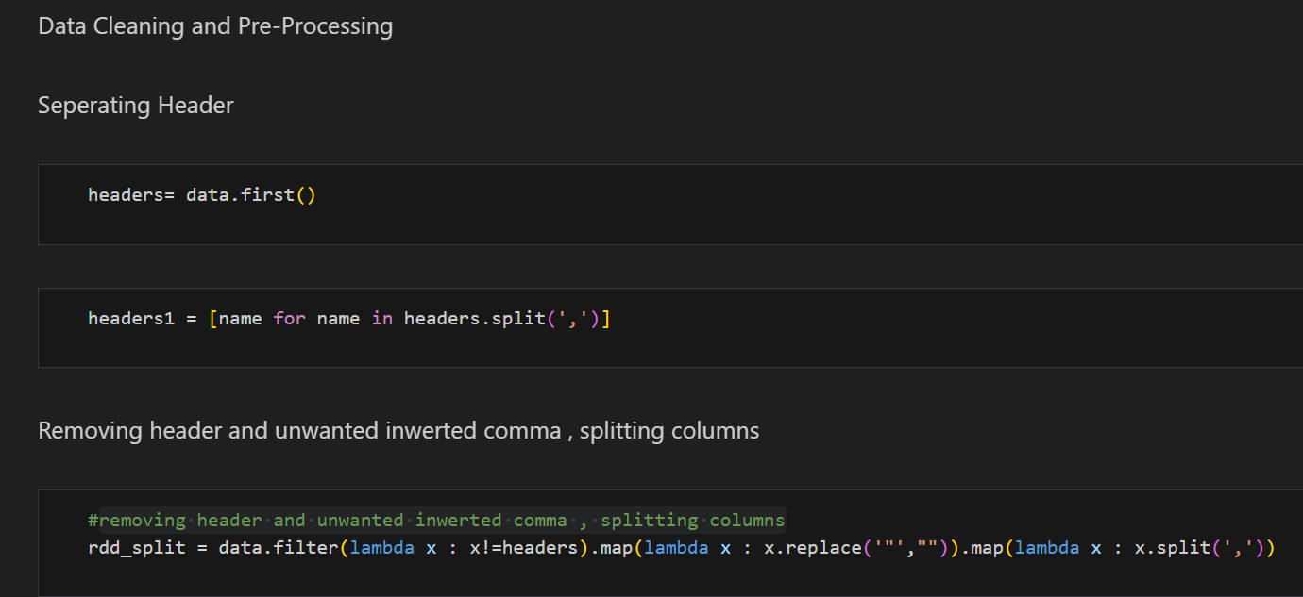
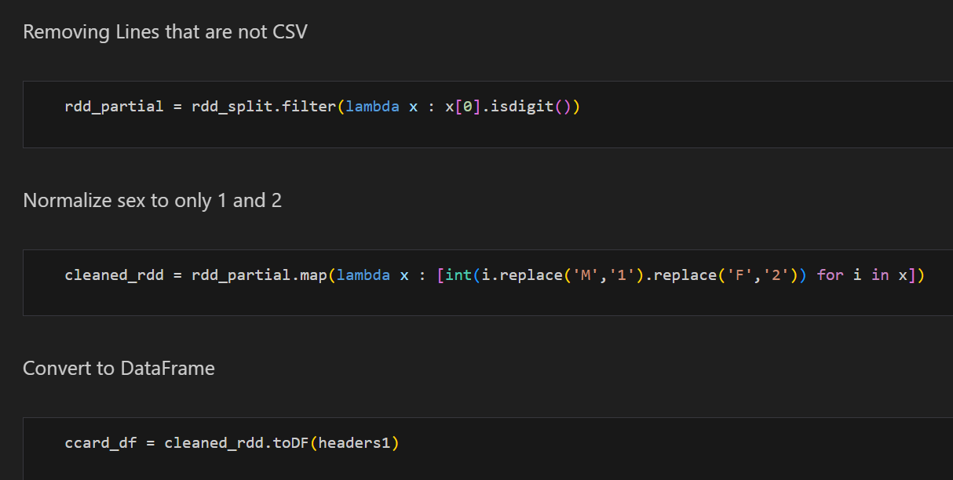
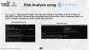
Risk Analysis using
Data Pre-Processing : In the initial five scenarios, the data cleaning and preprocessing tasks are executed within the Databricks environment

Slide 17
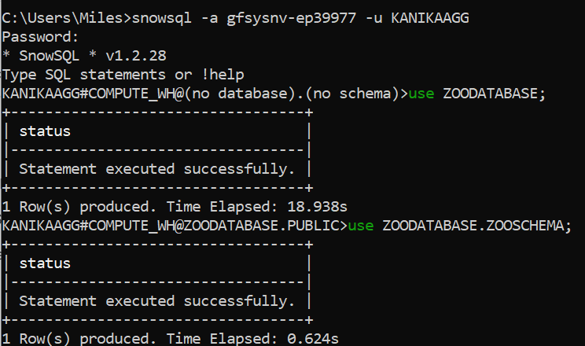
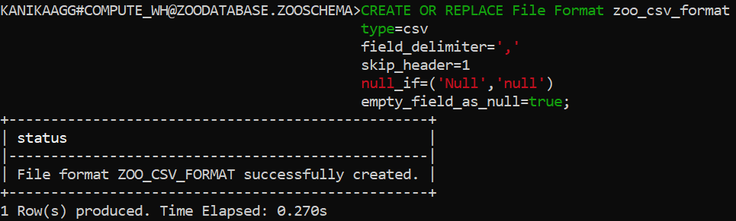
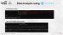
Risk Analysis using
Data Ingestion : Data Ingestion Pipeline from Data Lake Storage to Snowflake via External Stage and COPY INTO. From ADLS, the data is then seamlessly moved to Snowflake, a data warehouse platform, in order to facilitate subsequent in-depth analysis and exploration
Connecting with SnowSQL
Create File Format

Slide 18
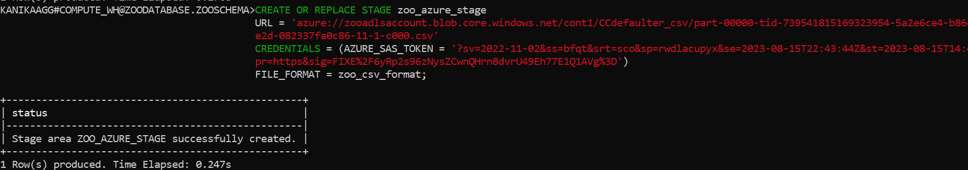
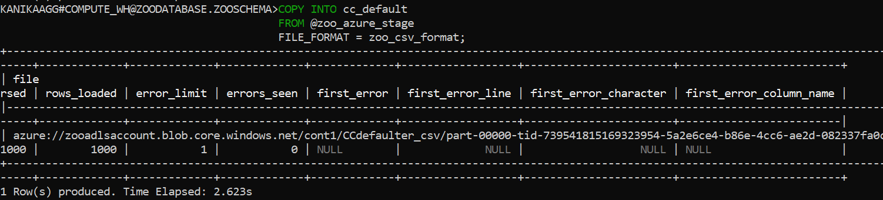
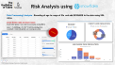
Risk Analysis using
Create External Stage
Copy Into Snowflake Internal Table

Slide 19
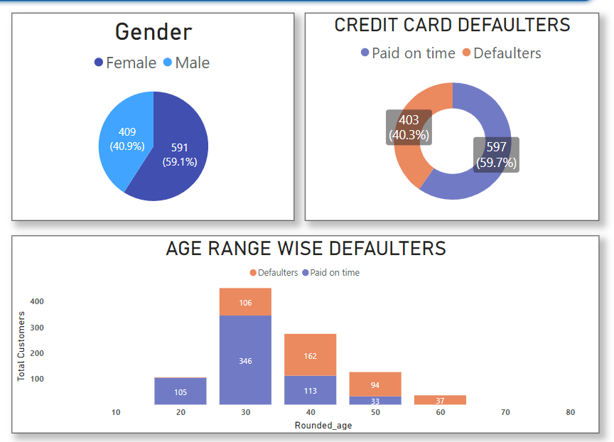
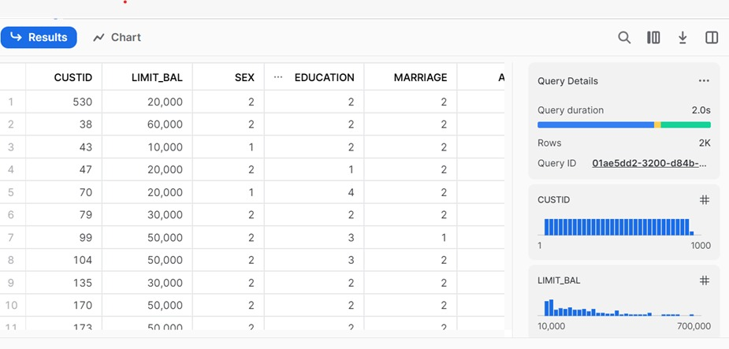
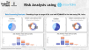
Risk Analysis using
Data Processing/ Analysis : Rounding of age to range of 10s and add SEXNAME to the data using SQL Joins.
Create Gender table and insert values
Create table gender ( sex_code int, sex_name varchar(50) );
select *, FLOOR((Age + 5) / 10) * 10 AS RoundedAgefrom cc_default c inner join gender g on c.sex=g.sex_code;
OPTIMIZED

Slide 20
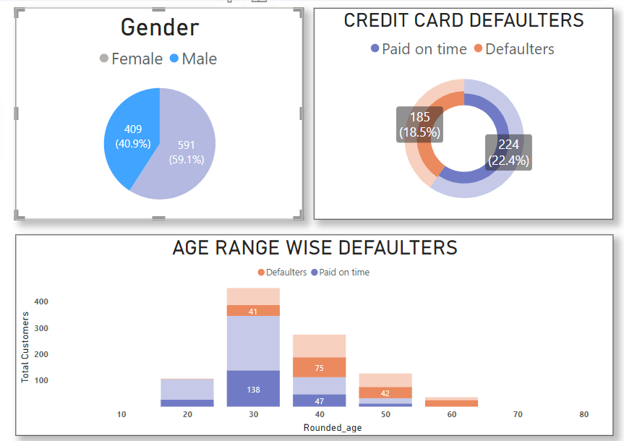
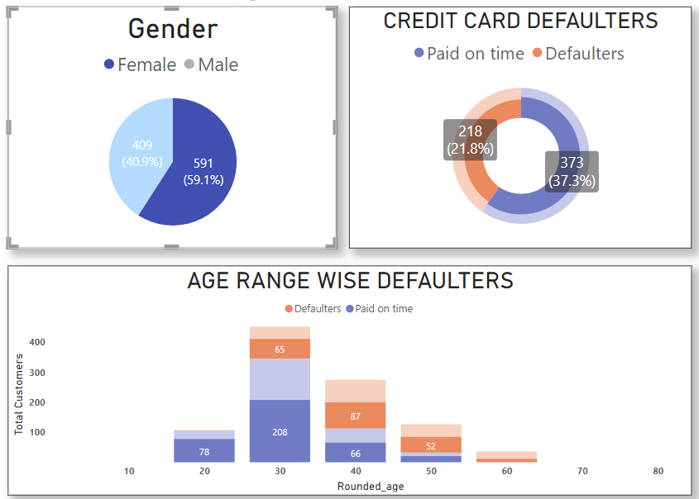
Risk Analysis using
Data Processing/ Analysis : Rounding of age to range of 10s and add SEXNAME to the data using SQL Joins.

Slide 21
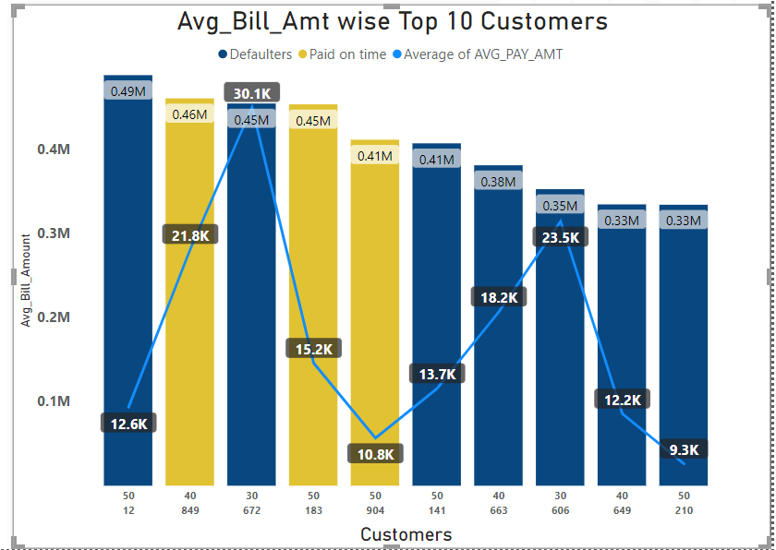
Risk Analysis using
Data Processing/ Analysis : Find Average billed Amount and average pay amount for each customer.
select *, ROUND(
(CASE WHEN BILL_AMT1 > 0 THEN BILL_AMT1 ELSE 0 END +
CASE WHEN BILL_AMT2 > 0 THEN BILL_AMT2 ELSE 0 END +
CASE WHEN BILL_AMT3 > 0 THEN BILL_AMT3 ELSE 0 END +
CASE WHEN BILL_AMT4 > 0 THEN BILL_AMT4 ELSE 0 END +
CASE WHEN BILL_AMT5 > 0 THEN BILL_AMT5 ELSE 0 END +
CASE WHEN BILL_AMT6 > 0 THEN BILL_AMT6 ELSE 0 END )/6,2)
AS AVG_BILL_AMT,
round((PAY_AMT1+PAY_AMT2+PAY_AMT3+PAY_AMT4+PAY_AMT5+PAY_AMT6)/6,2) AS AVG_PAY_AMT
FROM CC_DEFAULT;

Slide 22
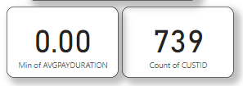
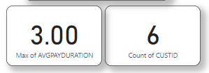

Risk Analysis using
Data Processing/ Analysis : Find average pay duration. Make sure numbers are rounded and negative values are eliminated.
SELECT *, ROUND ((
CASE WHEN PAY_1 > 0 THEN PAY_1 ELSE 0 END +
CASE WHEN PAY_2 > 0 THEN PAY_2 ELSE 0 END +
CASE WHEN PAY_3 > 0 THEN PAY_3 ELSE 0 END +
CASE WHEN PAY_4 > 0 THEN PAY_4 ELSE 0 END +
CASE WHEN PAY_5 > 0 THEN PAY_5 ELSE 0 END +
CASE WHEN PAY_6 > 0 THEN PAY_6 ELSE 0 END
)/6, 0) AS AVG_PAY_DURATION
FROM
CC_DEFAULT;

Slide 24
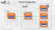
Batch Processing using RDD

Slide 25

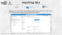
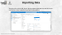
Cluster Configuration
AM
WORKER
EXECUTOR
CORE
CORE
CORE
CLIENT
CLUSTER MANAGER
ROM – 1 TB, RAM – 32GB, 8 CORES
DRIVER
MASTER
WORKER
SparkContext
EXECUTOR
EXECUTOR
CORE
CORE
CORE
CORE
CORE
CORE
ROM – 1 TB, RAM – 32GB, 8 CORES
ROM – 1 TB, RAM – 32GB, 8 CORES
WORKER
EXECUTOR
CORE
CORE
CORE
ROM – 1 TB, RAM – 32GB, 8 CORES

Slide 26
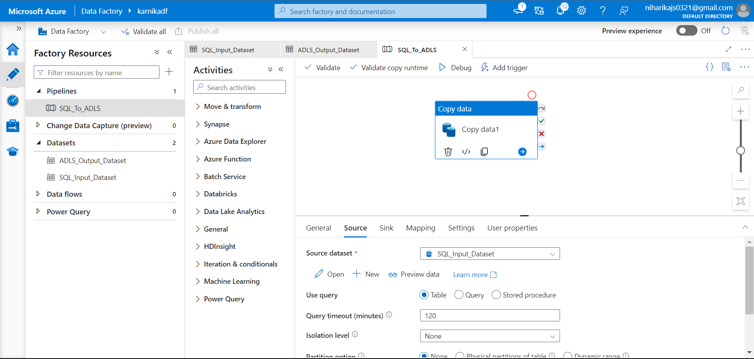
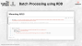
Importing Data
The source for us is MS SQL Server. We are importing the data from the SQL Server into the Azure cloud, using the Azure Data Factory pipeline.

Slide 27
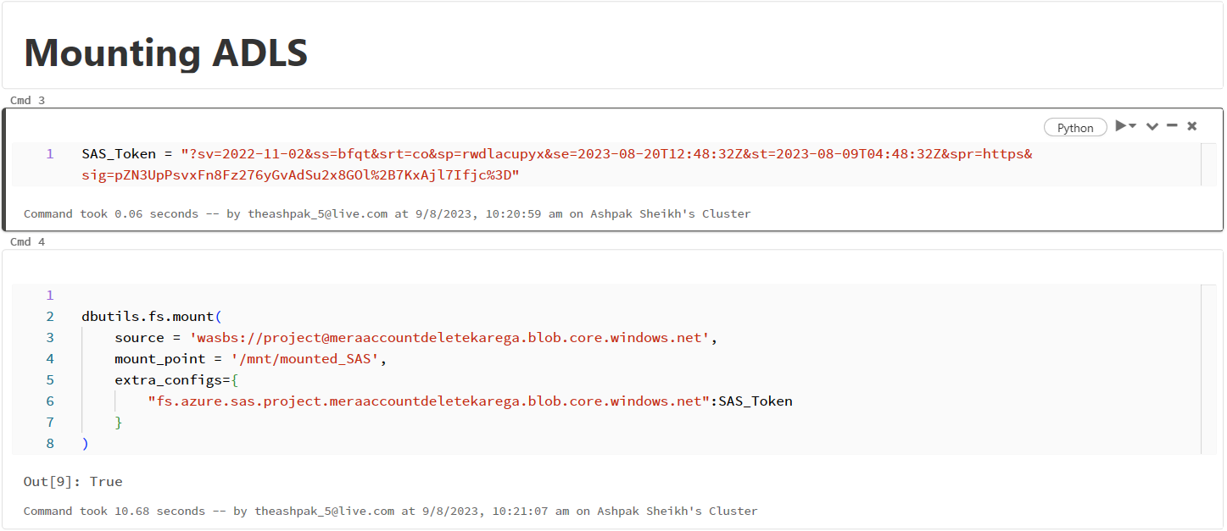
Batch Processing using RDD

Slide 28
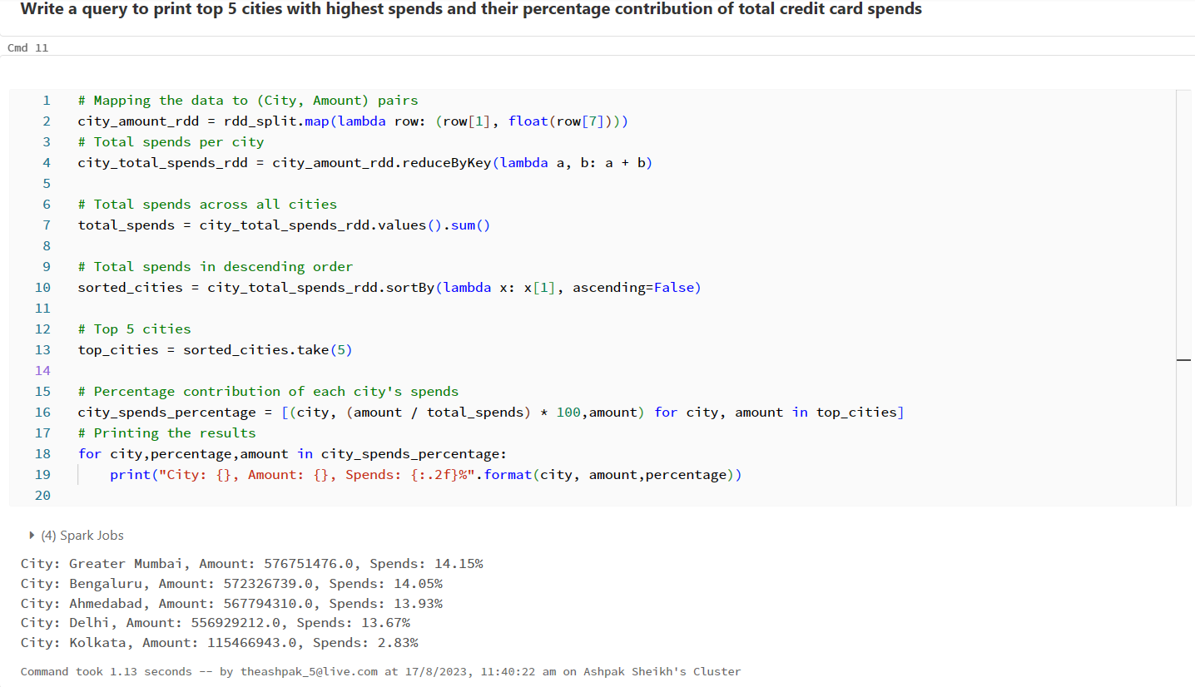
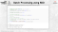
Batch Processing using RDD

Slide 29
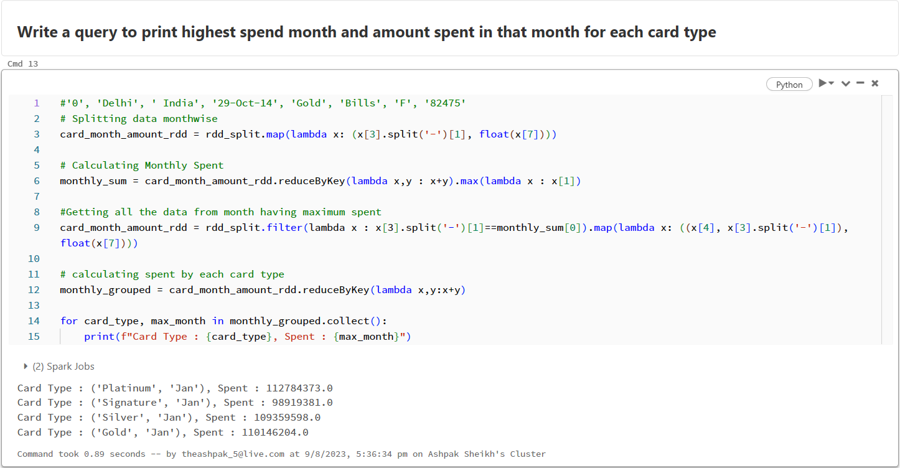
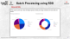
Batch Processing using RDD

Slide 30
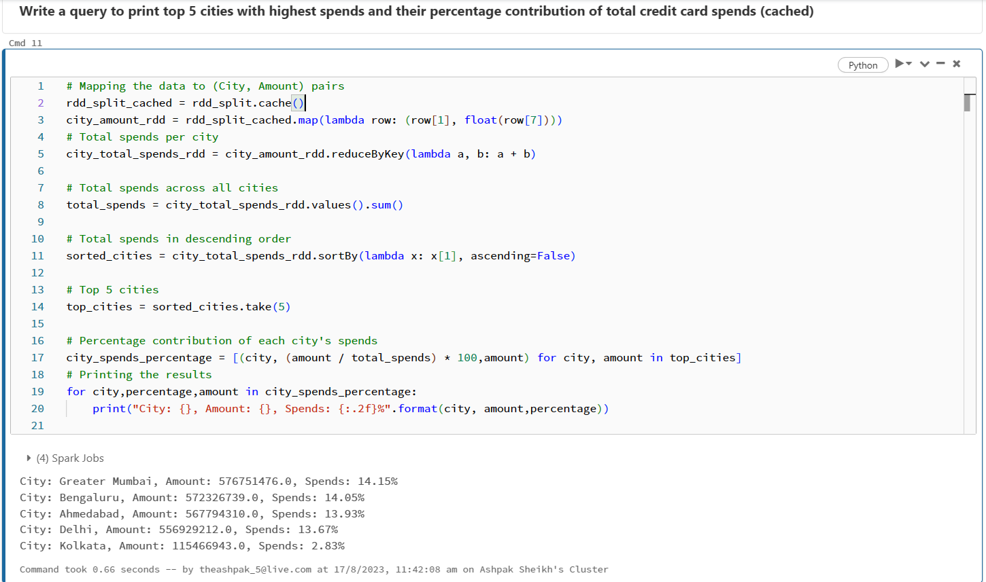
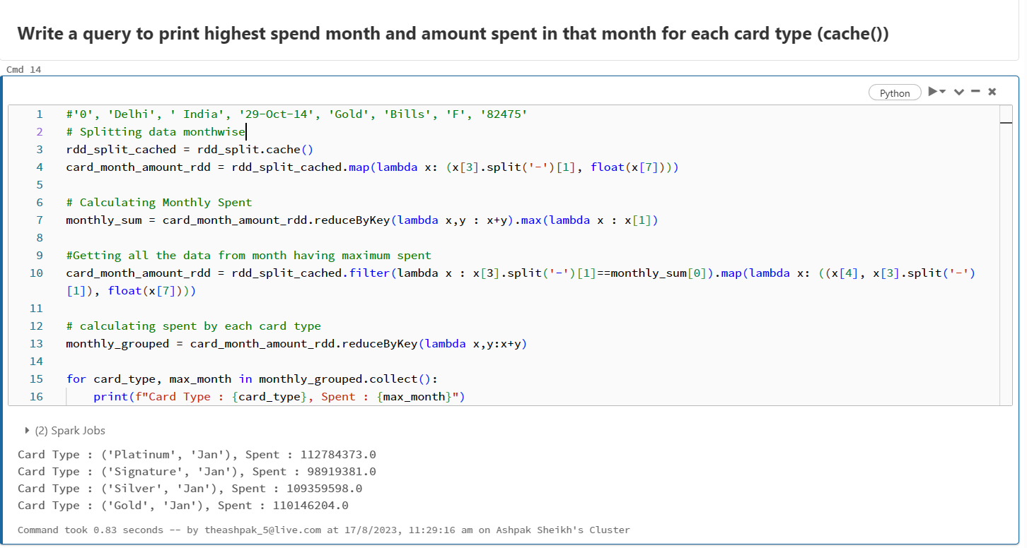
Optimization using RDD
OPTIMIZED

Slide 31
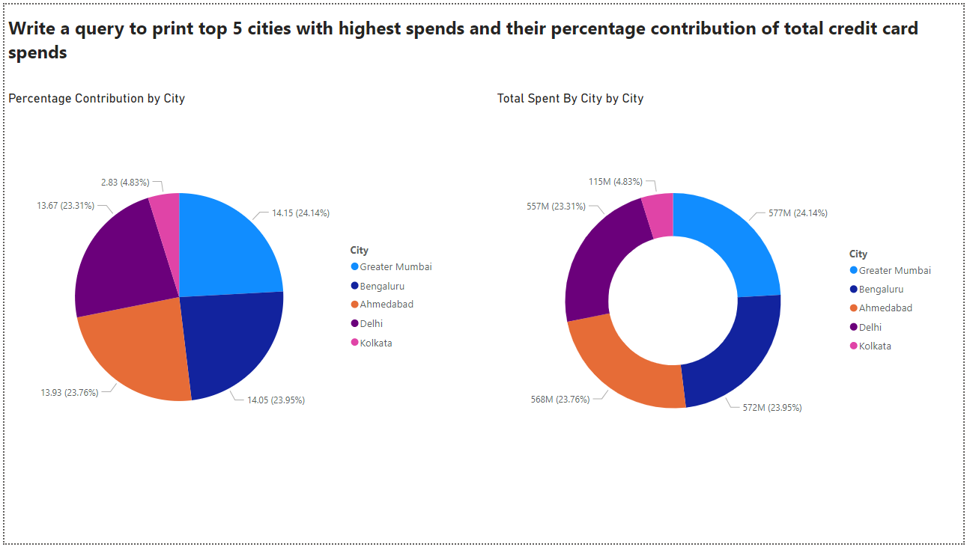

Batch Processing using RDD
VISUALIZATION:

Slide 32


Batch Processing using RDD
VISUALIZATION:

Slide 33

Batch Processing using RDD
Scenario 6 - Write a query to find percentage contribution of spends by females for each expense type

Slide 34

Batch Processing using RDD
VISUALIZATION:

Slide 35


Batch Processing using RDD
Scenario 7 - Which card and expense type combination saw highest month over month growth in Jan-2014

Slide 36

Interactive Processing using DataFrame

Slide 37



Connecting to Azure SQL Database & Reading the data

Slide 38



Cleaning Data and Creating Temporary Table

Slide 39


Problem Statement
Write a query to print 3 columns: city, highest_expense_type, lowest_expense_type

Slide 40


Problem Statement
Output:

Slide 41


Catalyst Optimizer
OPTIMIZED

Slide 42


Exporting result to Azure SQL Database

Slide 43


Visualization

Slide 44



Problem Statement
Which city took least number of days to reach its 500th transaction

Slide 45


Scheduling Databricks Notebook in ADF for Periodical Analysis

Slide 46


Roadblocks
Faced issues with data understanding and handling irrelevant data.
Resolution: Consulting with domain experts who can help you determine which features are important for credit card analysis.
The automated data ingestion Snowflake pipeline from ADLS to Snowflake encountered challenges due to a region mismatch between the two platforms and unavailability of an enterprise version of Snowflake.
Resolution: Manually loaded the data using COPY INTO and External stage for data ingestion.

Slide 47



Conclusion
Customer Insights: Through in-depth analysis, we gained valuable insights into how customers use their credit cards, revealing spending patterns and preferences.
Risk Identification: Our analysis helped identify potential risks, enabling us to proactively manage and minimize the chances of defaults.
Smart Decisions: Armed with data-driven insights, we can make informed decisions that benefit both customers and the business.
Financial Well-being: By analyzing behavior, we contribute to customers' financial well-being by offering suitable credit limits and advice.

Slide 48
Thank You

